Slide 1
Twitter and Politics
Dr. Anne Regel
March 16th, 2018

Slide 2
Introduction
Politicians are increasingly using Twitter to communicate directly with the public
All 100 senators have official twitter accounts
All but 7 congresspersons have twitter accounts
Presidents and Prime Ministers
France, Russia, Venezuela, UK and Israel
What can 280 character's do?
Effect stock prices
Influence diplomacy
Inspires violence

Slide 3
Twitter and President Trump
This capstone project will analyze President Trump’s tweets. Some of the questions I will try to answer are:
What does President Trump tweet about?
Do his tweets translate into official actions of any kind?
My clients would include anyone interested in using twitter statements in order to anticipate future actions made by the President of the United States of America

Slide 4
Data Acquisition
Twitter
Tweets from 01/20/2017 – 03/03/2018 obtained from Trump Twitter Archive
Tokenized tweet text
All documents published by the Executive Office of the United States of America
Scraped all documents from the Federal Register’s website
Converted PDF to text
Tokenized each documents text

Slide 5
Data Wrangling
Text pre-processing
Pdf to text
Extracting features
Hashtag and @mentions
Date
Text tokenization
Text
Text to matrix
Topic identification, NMF

Slide 6
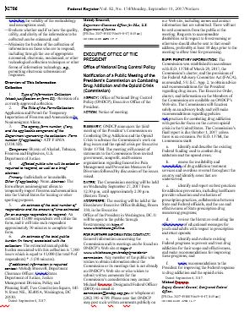
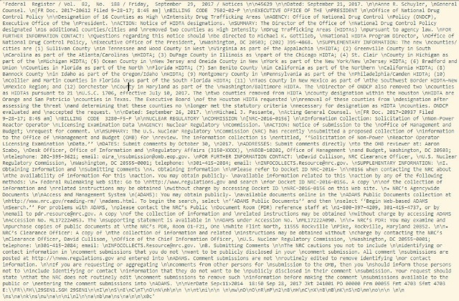

# Hashtags
Extract
@mentions
Date of publication
Tokenize Text

Slide 7
Exploratory Data Analysis and Visualization
Top words
Top shared words
Example of document topics

Slide 8
Cosine Similarity

Slide 9
Analysis Results

Slide 10
Topics of Similar Documents

Slide 11
Conclusion

